Slide 1

Iteration 3
FINAL SUBMISSION

Slide 2

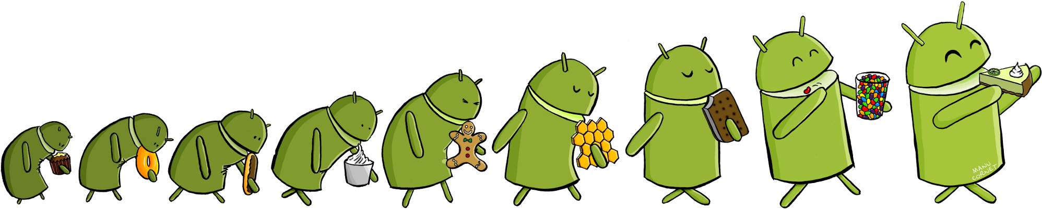
AGENDA
Overview
Requirement Analysis
Project Management
Software Design
Implementation
Quality management
Testing

Slide 3
OVERVIEW
EDUkid Mission Statement
We strive to give children just the right balance between education and fun.
So our games don't feature fun at the expense of education – or education at the expense of fun.

Slide 4
We have included features like:
customizable menus
play-timer
which makes this app a complete delight for parents allowing them to control the usage time of their children

Slide 5


Requirement Analysis
User stories
Account Creation Story
Setting Passcode Story
Alphabet Learn Mode Story
SQL Settings Database Story
Other tasks
Gathered images and words for Alphabet category
Refreshed app look and feel (new background images, etc.)

Slide 6
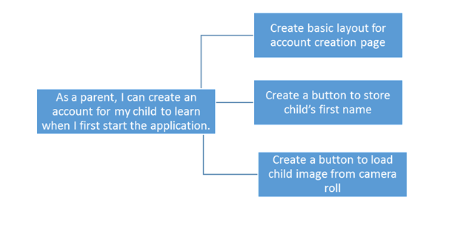
USER STORIES
Characteristics of good user stories:
the INVEST acronym is frequently used to describe attributes of a good user story:
Independent
Negotiable
Valuable/Vertical
Estimable
Sized Appropriately/Small
Testable

Slide 7
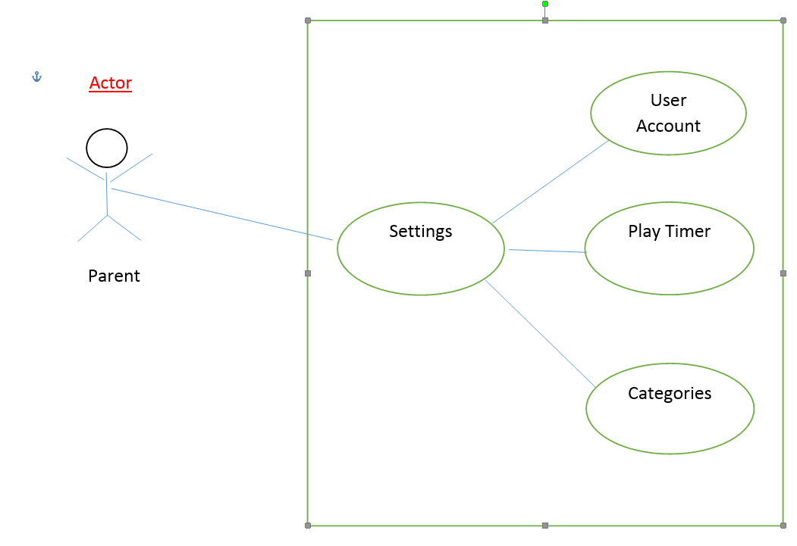
Use Case

Slide 8
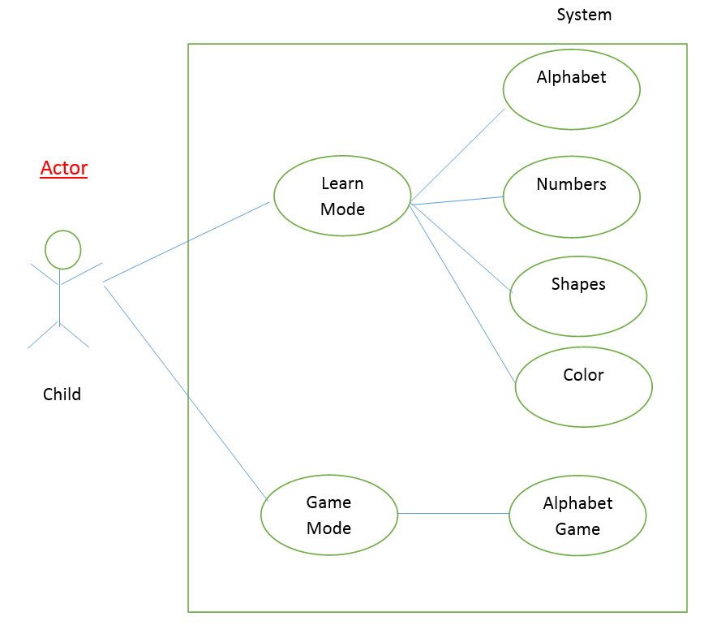
Use Case

Slide 9
Demo
USER ACCOUNT

Slide 10

Project Management
Pivotal Tracker
User Stories
Created by Group as per Requirement
Added by Customer as per Requirement
9 of 9 User Stories Completed
All bugs resolved
Velocity Acheived: 15
Lines of code:4127(Java Lines of Code)
Excluding XML
GitHub with 2 branches
Master branch
Development branch
Schedule
Maintained and Delivered based on a 3 week
iteration

Slide 11

Communication Method
Communication with group
Email, Google Hangouts
Weekly team meeting
Weekly status report
Documentation and meeting minutes
Communication with Customer
Pivotal Tracker
Weekly status report

Slide 12

Estimation
Project planning
Estimate the Work to be done
The resources required
Scheduling Time from start to finish
Scope and feasibility
Functions and features to be delivered to the end user
User stories
Availability of technology and time
Project resources
People, development environment and software

Slide 13

Risk Analysis
Risk Identification
Device Storage --> for default images
Device Constraints --> for devices with lack of Camera hardware
Device Constraints -->for image quality for low res. camera
Group Dynamics -->Group Members Learning Curve
Communication Aspects -->Sharing Information between groups
Risk projection
Categorize the risk as project risk or technical risk.
Risk % for above mentioned Risks are not more than 10-20%
100% Timely Delivery Assurance

Slide 14
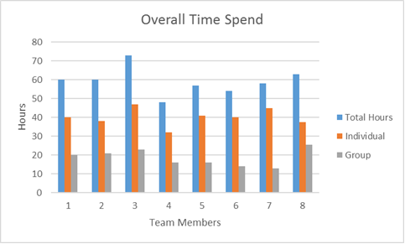
OVERALL TIME SPENT

Slide 15
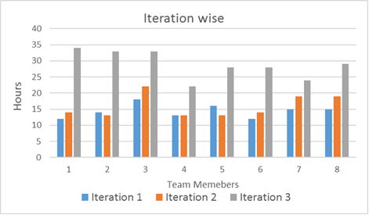
TIME SPENT IN EACH ITERATION

Slide 16

Software Design
Two modes:
Learning mode
Game mode
EDUkid is an Android Application to help children learn
Supports Letters, Numbers, Colors, and Shapes out of the box
Each category allows the parent to upload custom pictures for letters, words, shapes, etc. to personalize the learning
Allows for custom learning module creation

Slide 17
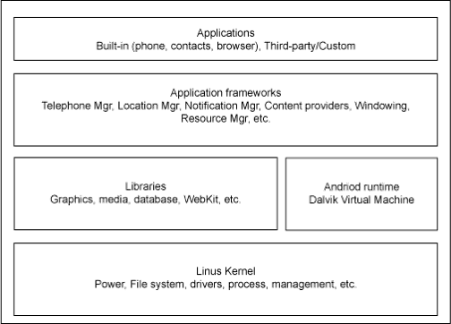
Software Design
Android Layered Architecture
The UI subsystem includes:
Windows
Views
Widgets for displaying common elements such as edit boxes, lists, and drop-down lists

Slide 18

Follow the MVC (Model View Control)
Database being integral part of App
Enables Customization features
Robust Architecture
Implementation of SQLite in Android SDK
Model: Class Declarations for each Table
Views: XML files for each Screen for Data Display
Control: Databse.java and DatabaseHelpers.java that contain Functions

Slide 19
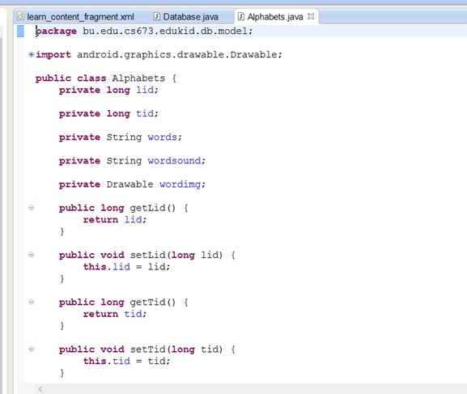
Model
For Alphabet Table

Slide 20
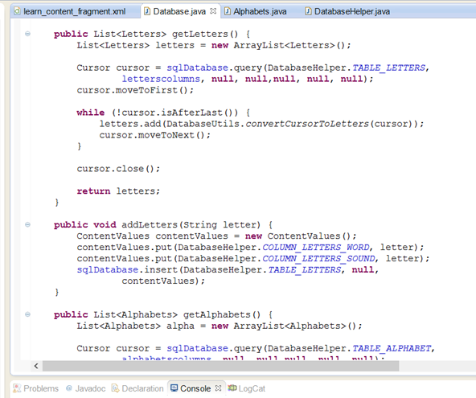
Control
For Alphabet Table

Slide 21
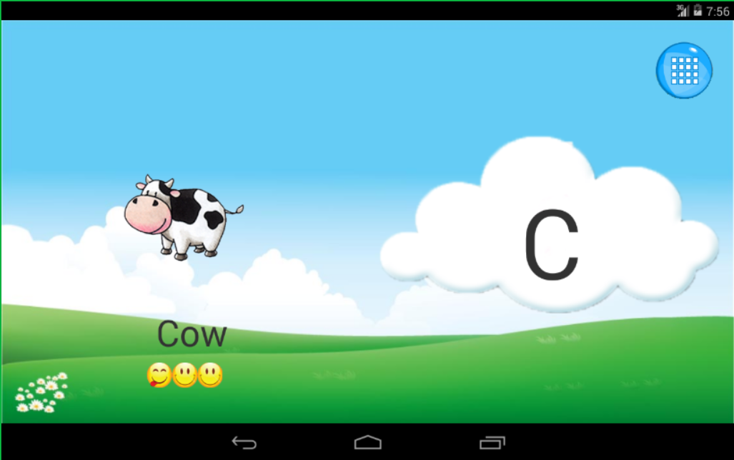
View
For Alphabet Table

Slide 22
CLASS DIAGRAMS

Slide 23
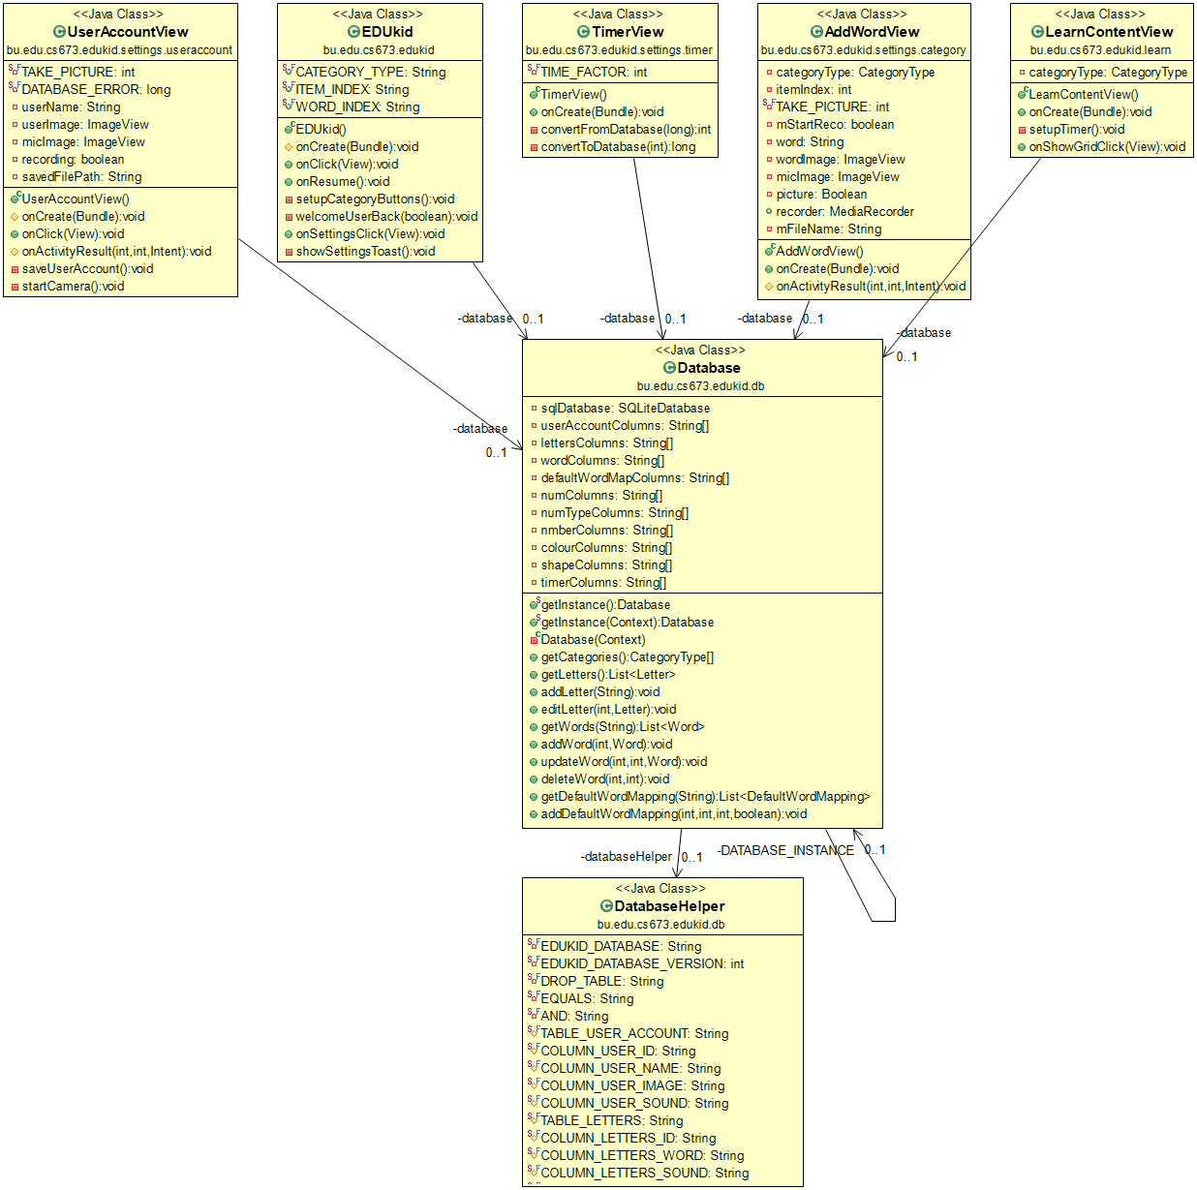
SOFTWARE ARCHITECTURE

Slide 24
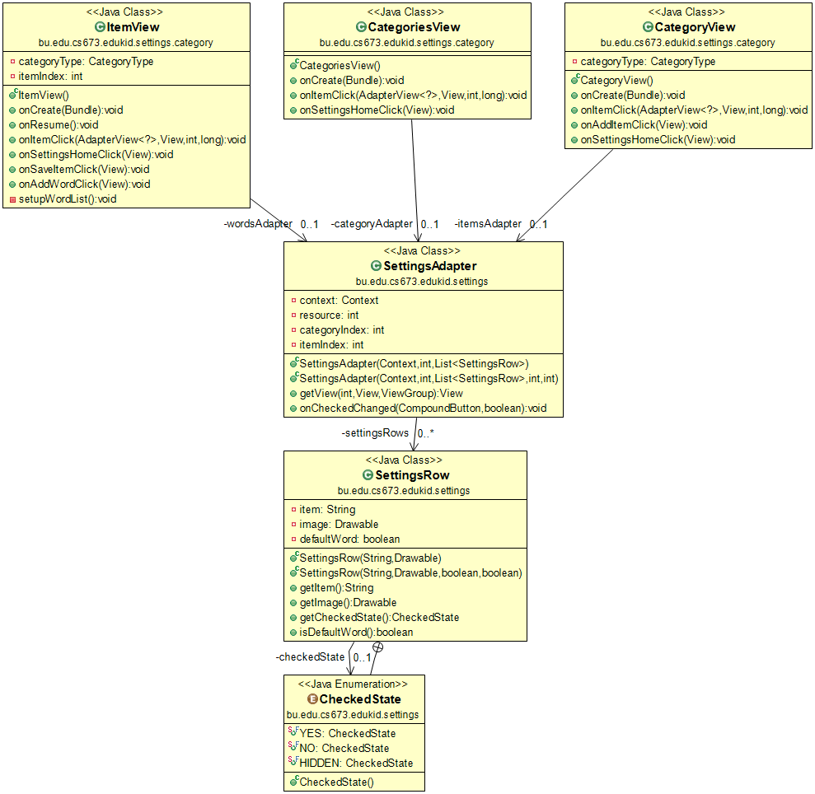

Slide 25
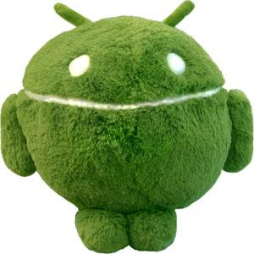
UI Implementation
Android Applications Divided into 2 Parts:
Functionality Controlled by Java Files
User Interface Controlled by XML Files
In our Application
We have XML Pages for Each Section
Splash Screen
Main Page
Game Page
Learn Page
Settings Page

Slide 26
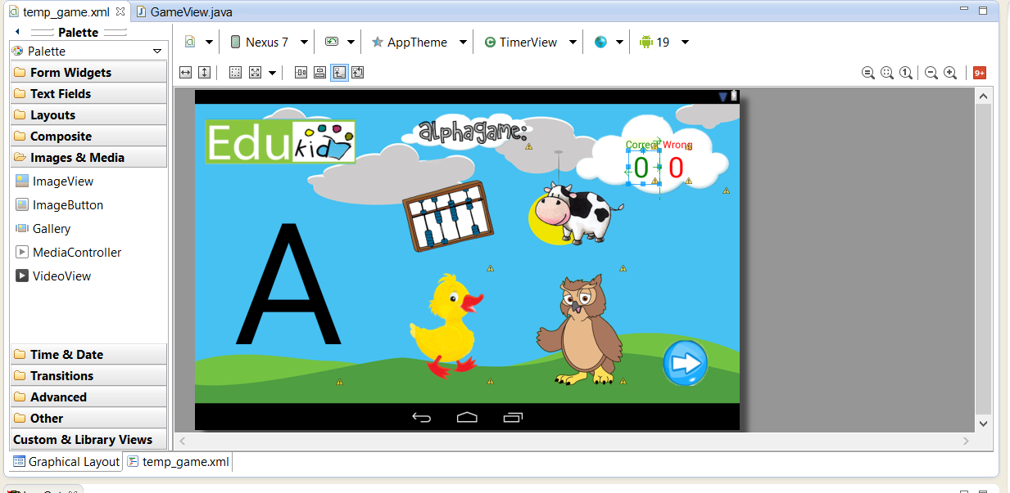
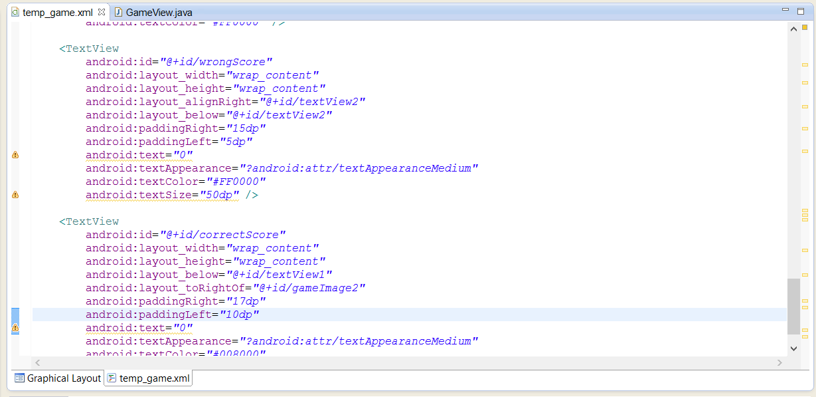
The XML views:
Graphical View
XML View

Slide 27
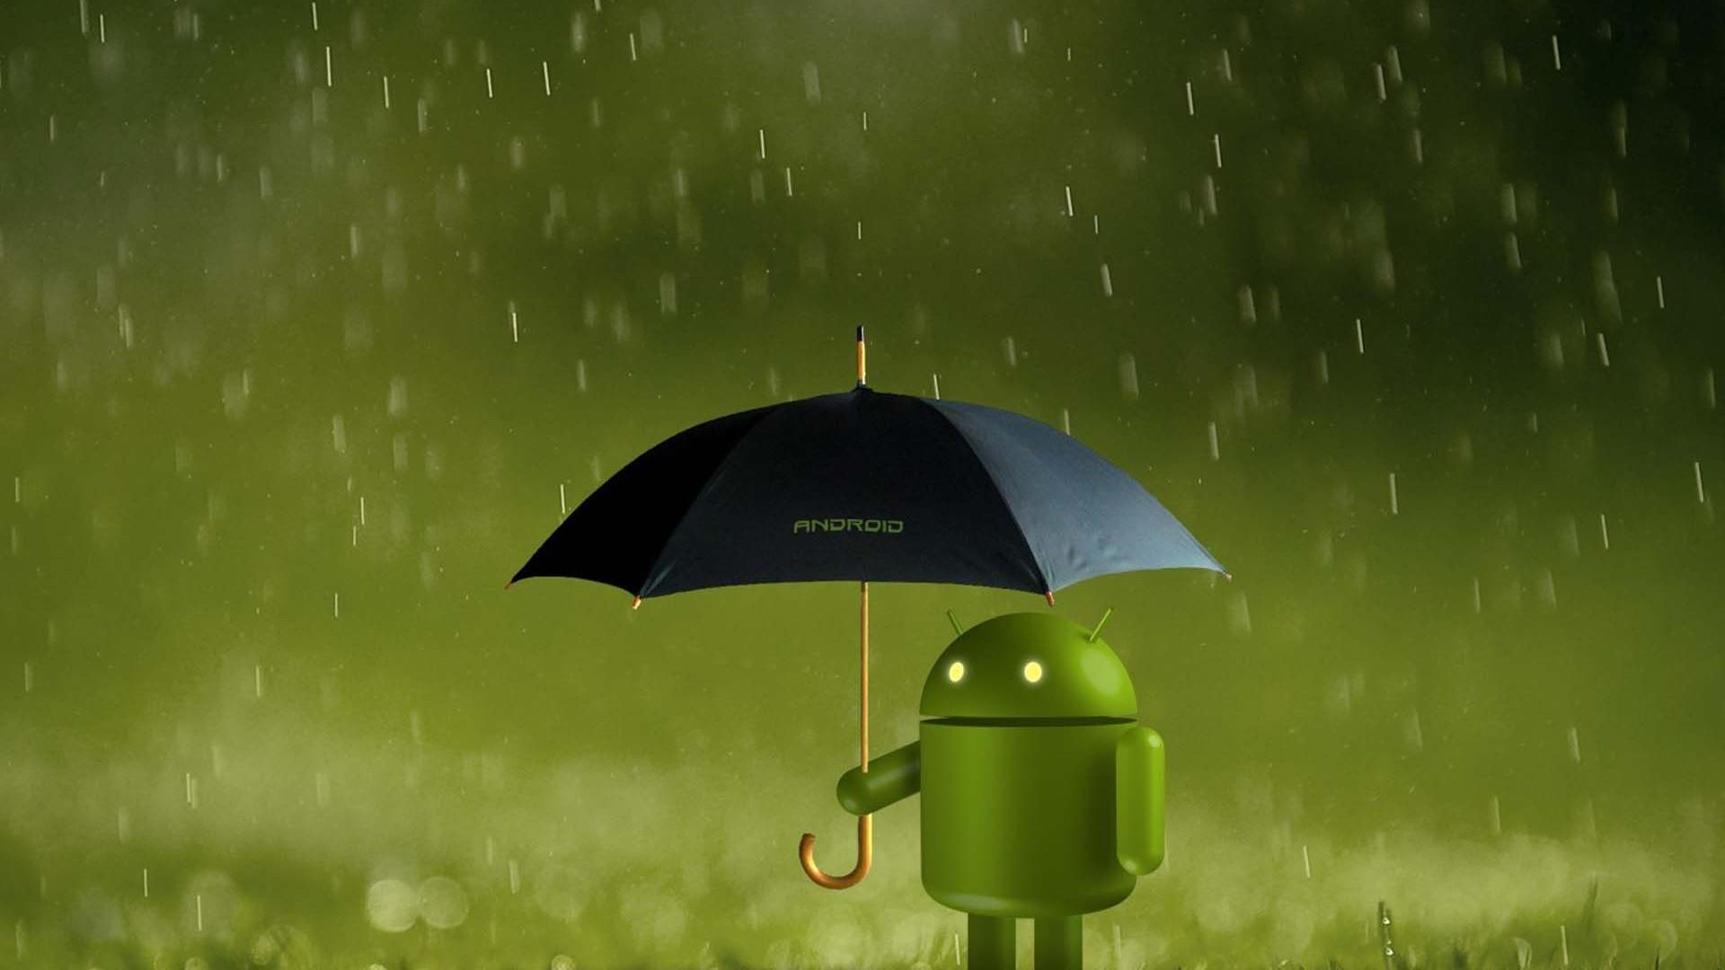
Effective UI Implementation
Effective Usage of a single Page View
The Layout adjusts as per the mode that you are in
Example: Learn Mode, Game Mode
Swipe Feature to move to next Object
Standardized Look and Feel
Colors to appeal a child
Use of Big and Easy to understand buttons and UI elements for a child
Example: Tiles, Big Buttons
Customization
Buttons
Toasts
Use of Android Widgets
Toasts
Toggle Buttons

Slide 28
Game Mode
Alphabet Game
Aim of the Game : Pick the corresponding image to the Letter shown
For every correct answer, we see the Green(Correct) Toast
For every wrong answer, we see the Red(Wrong) Toast
Custom Toast designs have been made for this mode.
Score Tracker

Slide 29
Demo
GAME MODE

Slide 30
IMPLEMENTATION

Slide 31
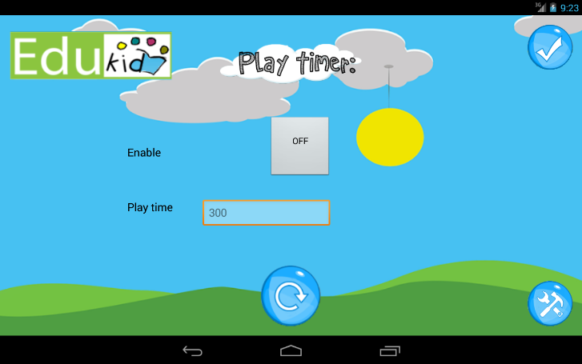
Timer Implementation
Great for timed-test preparation, measuring work speed and timing the game for the children.
Only the parents can access it as it is placed in the settings page of the app.

Slide 32
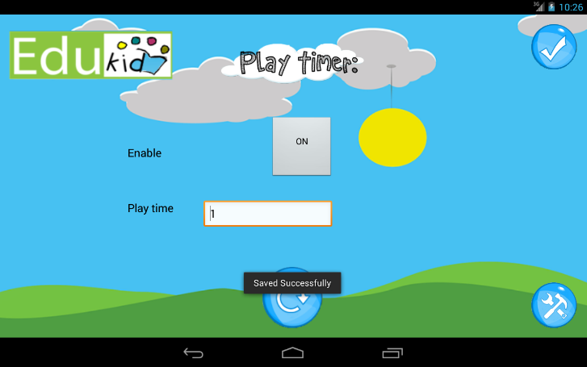
Timer Implementation
Initially turned off
Parents can decide the time limit for children and they can set the time in minutes using the play time field
The value then replaces the default value in the database.

Slide 33
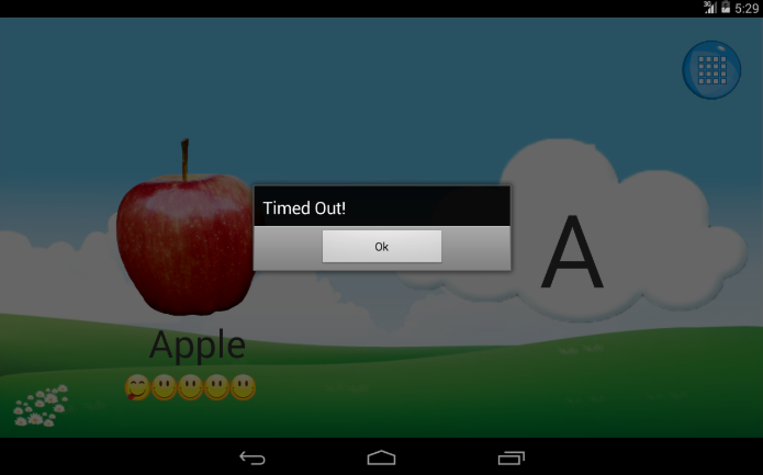
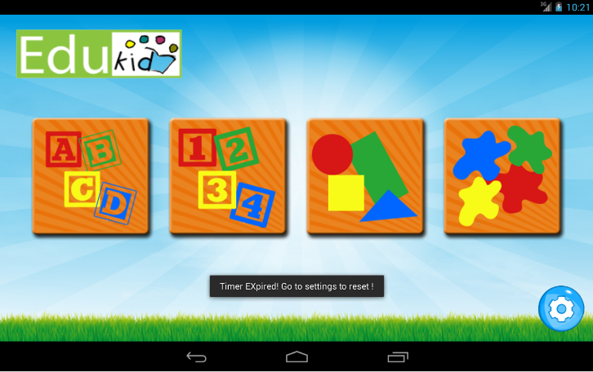
TIMER IMPLEMENTATION
Applies both to the learn mode and the game mode.
When the desired time limit is reached a message is displayed
It takes the child out of the mode back to the home page and the child cannot access any of the modes anymore

Slide 34

TIMER
To access the app again, the parents have 2 options :
Either turn off the timer completely
Or just press the reset button so that the timer starts again and would expire after the previously entered play time

Slide 35
Demo
TIMER

Slide 36
User Account
This table has the following columns:
-Column_user_id(primary key)-Assigns a unique id to each user
-Column_user_name-The name of the user
-Column_user_iamge-The image taken of the user through the camera app or camera roll
-Column_user_sound-name of the user is recorded while signing up or else text to speech is used to determining the sound
uid | username | userimage | usersound

Slide 37
Table Timer
table_timer – Game timer
expired - Boolean value set to true if the timer expires
enabled – Boolean value set to true if the timer enabled
Learntime – parents enable for child to play
expired | enabled | learntime

Slide 38
Letters
This table has the following columns:
- column_letter_id(primary key)-Assigns a unique id to each letter from a to z
- column_letter_word-This is the letter itself
- column_letter_sound-The sound of each letter
Letterid | letterword | lettersound

Slide 39
Words
This table has the following columns :
-Lid( foreign key)-This refers to the letter id in the letters table
-Wid-This refers to the word id in the table
-Word-Different word corresponding to the letters
-Wordsound-Sound for the different words using text to speech or recording by the user
-Wordimage-The images for each word ,default and user added
- Wordschecked – Visibility of the word determines by value 0 and 1
worditemid | wordswordid | wordsword | wordsound | wordsimage | wordschecked

Slide 40
Table Word Map
default word map categoryid –This refers to the category id
default word map itemid – Default database item
default word map wordid – default database words of the corresponding default database item.
default word map checked – default database checked of the corresponding default database item.
defaultwordmapcategoryid | defaultwordmapitemid | defaultwordmapwordid | defaultwordmapchecked

Slide 41
Word Mapping
dmapcategoryid | dwmapitemid | dwmapwordid | dwmapchecked
0 | 0 | 0 | 1
0 | 0 | 1 | 1
0 | 1 | 0 | 1
1 | 0 | 0 | 1
1 | 1 | 0 | 1

Slide 42
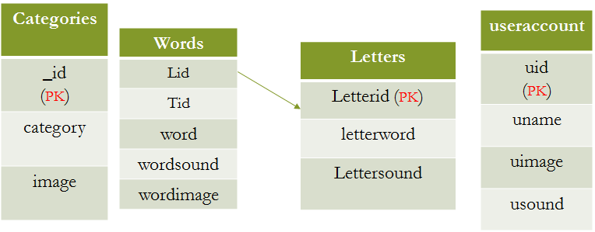
Database Schema

Slide 43
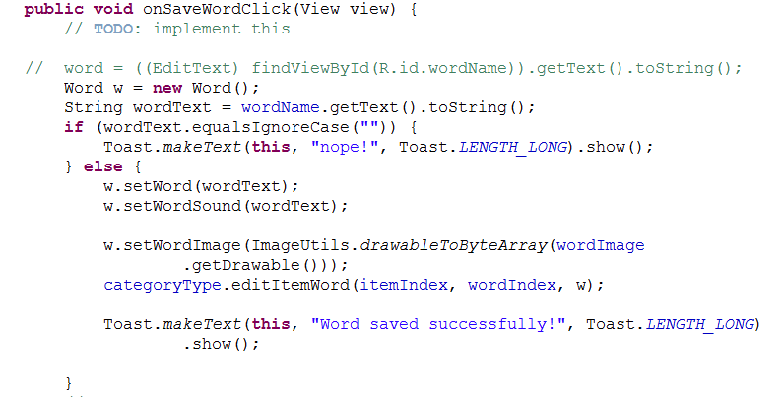
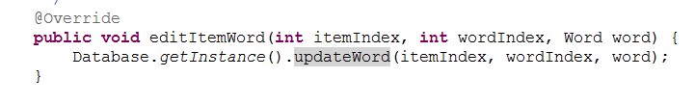

Slide 44
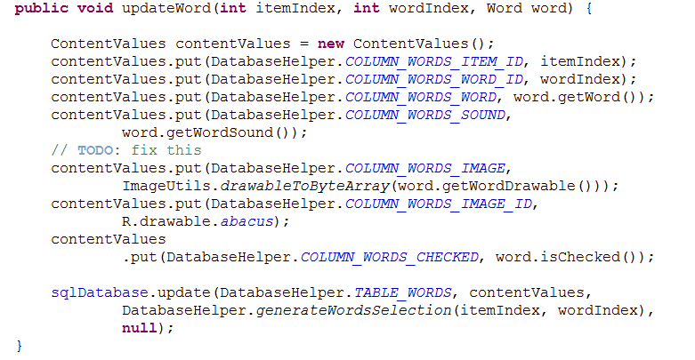

Slide 45
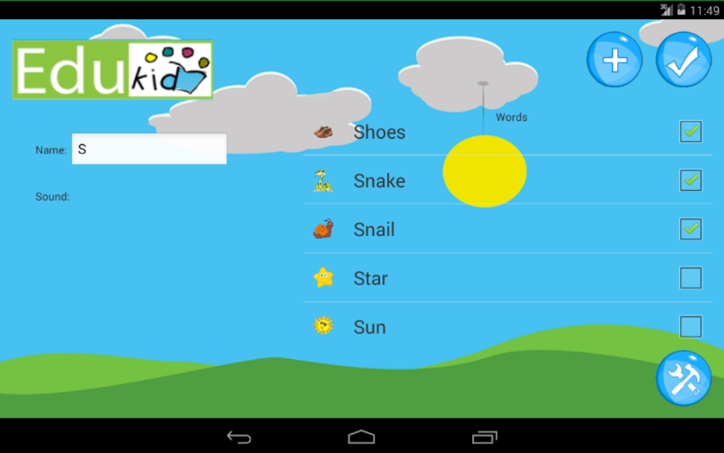

Slide 46
Demo
SETTINGS/LEARN MODE

Slide 47
QUALITY MANAGEMENT

Slide 48
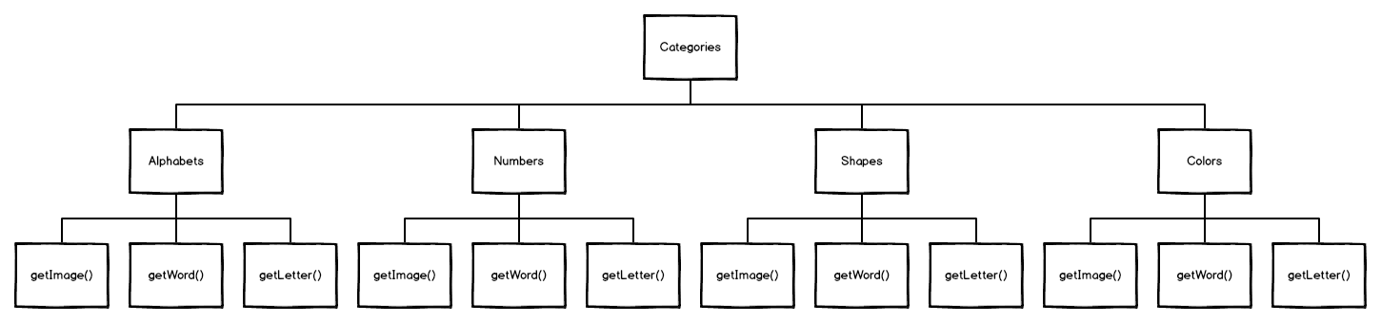
Refactoring
Initial Structure of App
Default Data Arrays, Data Objects made on the fly

Slide 49
Bad Smells Removed
We Observed:
Method Naming Flaws
Lack of Comments
Duplicate Data
Use of Arrays for Storing Large amounts of important data
Corrections Made:
Database Implemented to remove redundant array storage
Consistent Naming methodology adopted
Data Classes for Data Objects Made

Slide 50

Applying Refactoring Code following
Fowler’s Taxonomy:
Organizing Data
Replacing Array of Data Objects with Data Class
Initial Enums of Categories Refactored to Interfaces with Individual classes for each.
Correct Method Calls
Dealing with Generalization
Replacing Type Code
Creating Database Helper Class

Slide 51
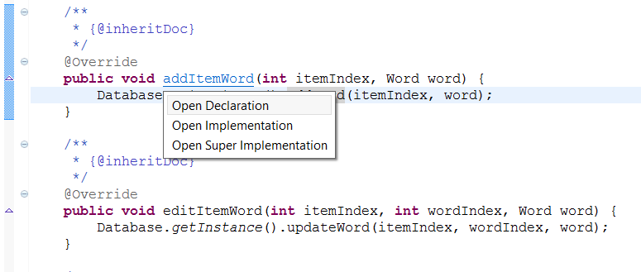
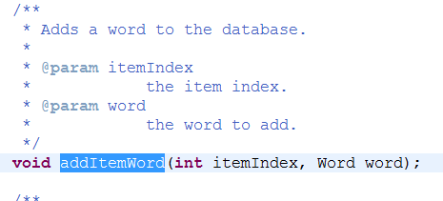
Replace Conditional With Polymorphism
“Super Implemented State”, Amalgation of Polymorphism and Inheritence
Example: AddItemWord method gets extended into Number, Shapes, and Color Category (inherits)
Goes to Database WORD Table Add the Word
Inside AlphabetCategory Class
inside Category Class

Slide 52
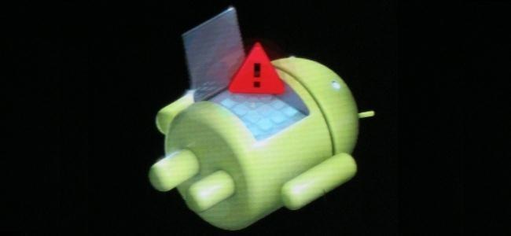
Testing Methodology
We followed an amalgamation of TDD and Integration testing
Testing Branch
All new features are tested in the testing branch(dev).
The branch maintainer checks the code and merges the
testing branch to master branch.
JUnit Testing for Settings Page Password
Android Test Cases are based on Junit.
Test package is created along with the android application
Two methods created for testing code for settings page
password.
testcorrectMathProblem test method we compare answers
with assertEquals
testfalseMathProblem test method we compare the
answer and Max value of integer with assertFalse
Database Testing
Database is build using SQLiteOpenHelper.
Database testing is also done using JUnit Testing.

Slide 53
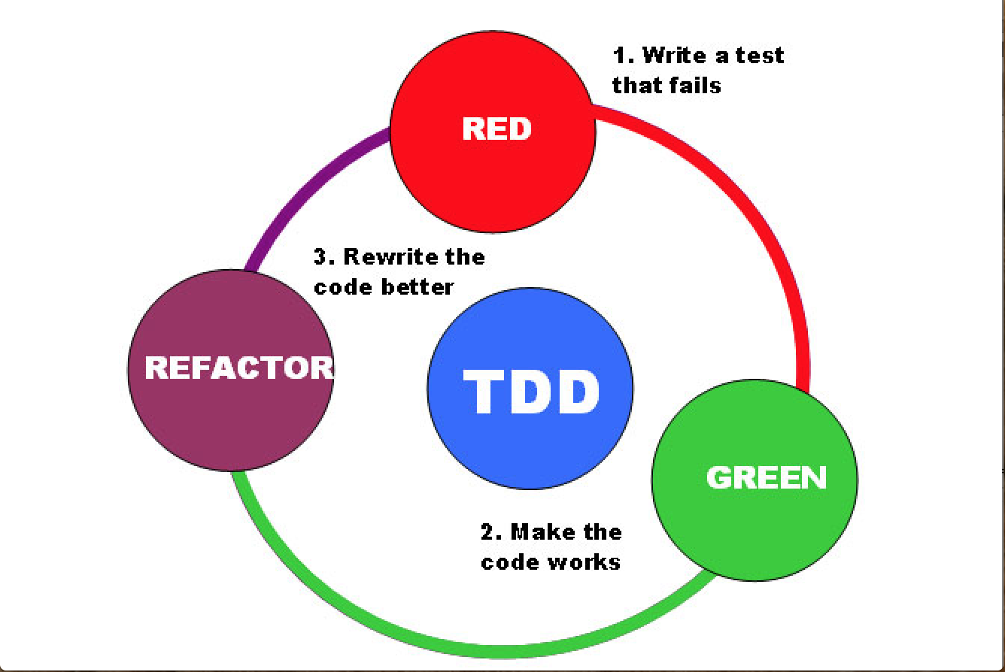
TDD

Slide 54
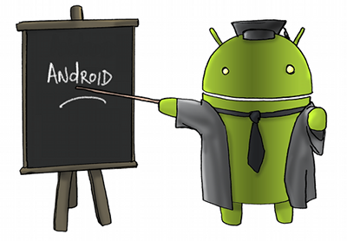
WHY TDD ??
Significantly decreased regressions
Refactoring becomes easier (and large, sweeping refactoring becomes possible)
Interfaces are better-designed
And result­ing imple­men­ta­tion tends to be simpler

Slide 55
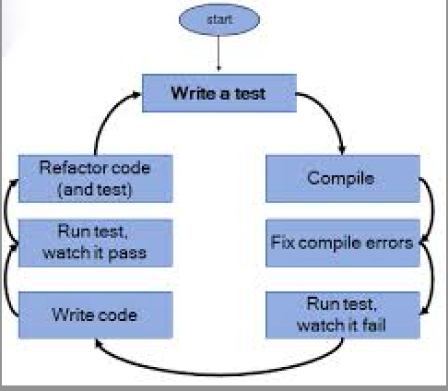
WE FOLLOWED

Slide 56
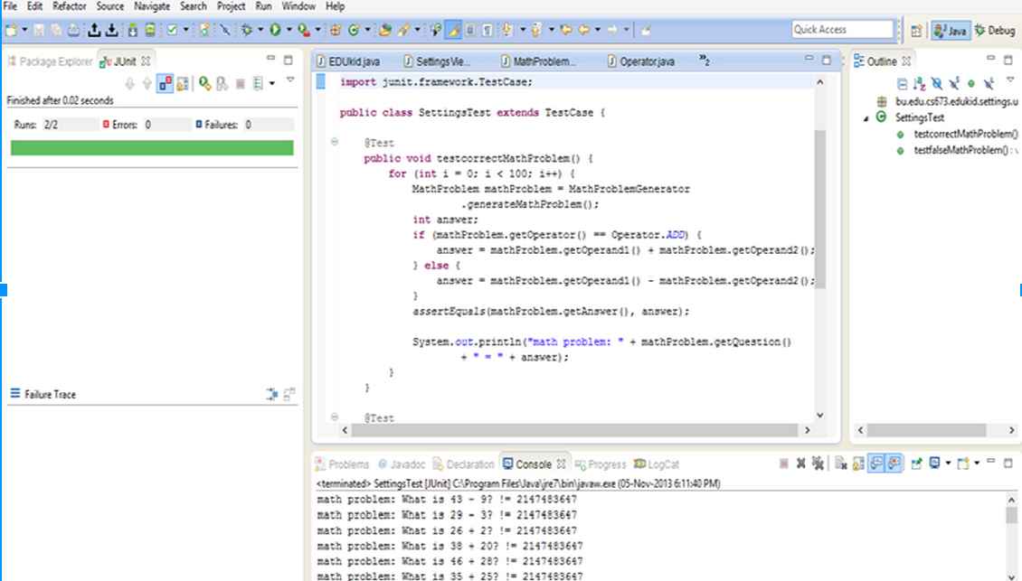
Example: We applied TDD

Slide 57
Demo
EDIT SETTINGS

Slide 58


COMING SOON TO GOOGLE PLAY STORE

